Slide 1
Implementation: Action & Communication
Step 3

Slide 2
Implementation
Once the problem has been defined & strategy worked out, the next important step is to put the plan into action & supporting it with communication
The role of PR has matured over time:
“How do I say it?”>“What shall I say?”>“What do I do?”
External & Internal tools are used for action & communication

Slide 3
External & Internal Tools:
Match Channel & TA
External
Media Writing
Events
Sponsorship
Company Website & blog
Word of mouth
New Media Presence
Internal
In-house Newsletters
Company Events
Internet & Intranet
W-O-M (grapevine)
Dialogues & feedback via brainstorming, bulletin boards & idea boxes
Notes:
Match in channel & TA: No use of media relations if your primary audience doesn’t read: Public health Campaigns

Slide 4
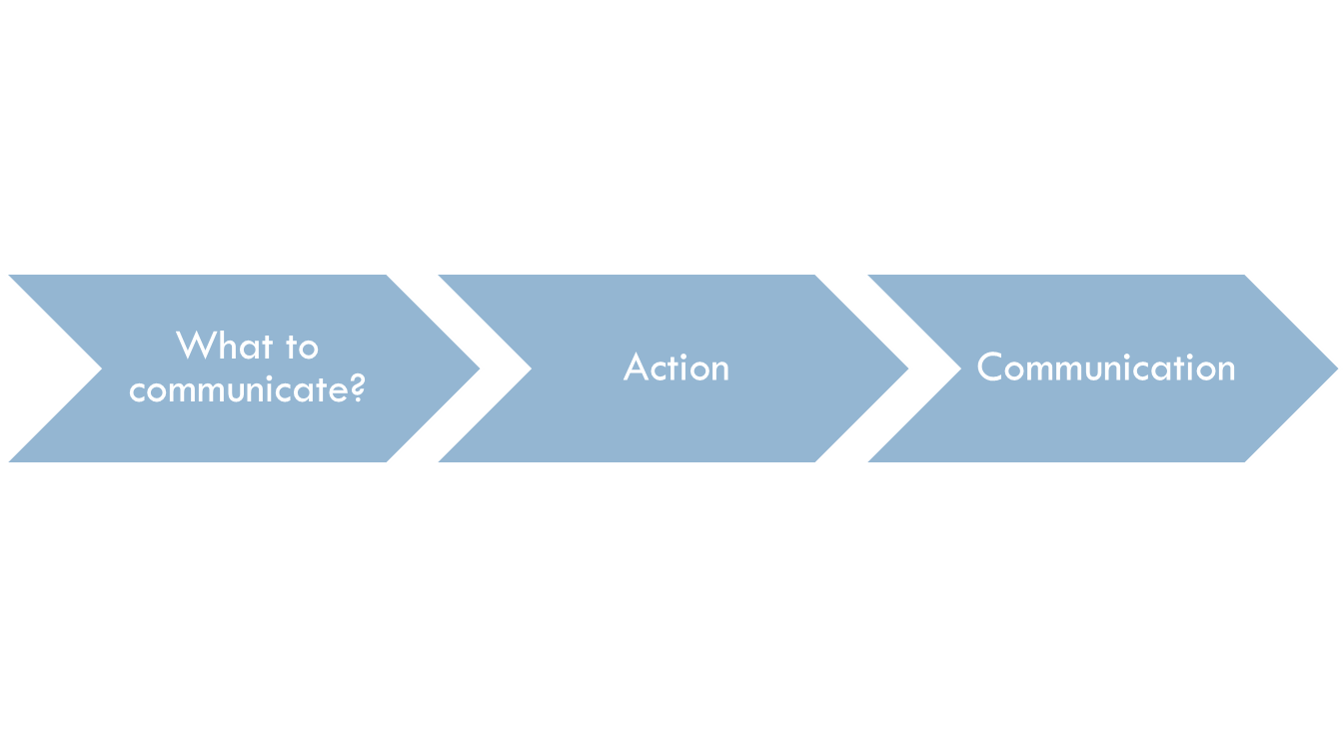
The Process of Implementation

Slide 5
The Process of Implementation
Phrasing of the message - What is it that you want to say? Why was this public relations campaign developed? It is based on your strategy statement
Activities - The actual steps taken to advance your cause and achieve your goals such as giving a speech, donating to a charitable organization, sponsoring a community event, organizing a blood drive
Medium of communication - Communication is the more visible component. Print? Broadcast? Your Web site? Word of mouth? Social Media?

Slide 6
What to communicate?
PR practitioners must frame their messages to make them newsworthy hence it is important to know all about media & media gatekeepers
Messages must be understandable –uncomplicated, free of jargon & simple to grasp, topical & local i.e. timely & close to home
Message must be immediately actionable-content should be such that it answers questions, responds to audience interest & serves to fulfill the objectives

Slide 7
Action & Communication Aspects
Case Study contd…...
The first stage launched to the trade press, followed by a national campaign launch on 3 December.
The team released a survey looking at willpower in greater detail. This was followed with a second survey during the Christmas party season looking at what men think they are like when drunk, compared with what women think.
New Year’s resolutions coverage was also piggybacked with a survey about top things that people gave up and how long their willpower lasted.

Slide 8
Action & Communication
Case Study contd…...
Alongside news coverage, journalists were invited to become Dryathletes and given kits that included a personalized running vest.
Selected celebrities took part and offered mentorship to other Dryathletes with regular personalized social media support.
To regionalize the launch, tailored stats on local cancer diagnosis rates and information from the willpower survey were used to keep it feeling relevant. This was followed by stories on cancer survivors.

Slide 9
Action & Communication
Case Study contd…...
In January, accusations that the campaign could encourage binge drinking stirred a debate, with potential reputational threat to the charity. As part of a response, case studies of people whose booze-free month had led to a healthier relationship with alcohol were put forward in the media.
All of the work was backed up by integrated social media activities.

Slide 10
Tylenol Crisis: J &J
In 1982, seven people died from cyanide-laced Tylenol capsules in the Chicago area.
Johnson & Johnson, controlled 37 % market with revenue of about $1.2 million.
Immediately after the cyanide poisonings, its market share was reduced to 7%

Slide 11
Coordinating Action & Communication
Alert consumers nationwide via media, not to use capsules until the extent of tampering could be determined
Stop production & halt advertising
Recall all Tylenol capsules
Inform internal & external stakeholders: Consumers, pharmacists, hospital staff, medical & general press
Full, candid media co-operation to get facts to the public as quickly as possible
Design & produce tamper-resistant packaging

Slide 12
Follow-up
Johnson & Johnson took the following steps to re-introduce the product
1. Tylenol products were re-introduced containing a triple-seal tamper resistant packaging
2. Over 2250 sales people made presentations for the medical community to restore confidence on the product.
3. Within six months of the catastrophe, the company had recovered 70%
Read more: http://aboutpublicrelations.net/uczoulas1.htm

